Slide 1
Is this still a debate?
Solange Baptiste
July 25, 2018
Executive Director
International Treatment Preparedness Coalition

Slide 2
About ITPC
Birthed in South Africa in 2003 when < 500,000 people had access to ART given that it cost more than $10,000 per person per year.
Mission: To enable people in need to access optimal treatment.
#TreatPeopleRight
#MakeMedicinesAffordable
#WatchWhatMatters
Global community voice
on treatment access!

Slide 3
COMMUNITY PERSPECTIVES
Community survey of 12 countries on access to viral load testing. [2015]
Rapid assessment on ‘readiness’ of patients and communities to advocate for differentiated models of ART delivery. [2016]
Three (3)-day consultation with 75 PLHIV leaders from all CQUIN countries on barriers to DSD scale up and RVLT access. [2017]
A five (5)-day intensive community workshop on RVLT/DSD with 30 activists across 12 countries from seven (7) networks of people living with HIV in Asia and Africa. [2017]
Baseline results on RVLT access from Global Fund project in 11 West African countries. [2017]
Preliminary findings from Global Treatment Survey in 15 countries. [2018 On-going]
15 years of experience across 9 Regional ITPC Networks, Global & Regional CABs, Global Community Consultation on PrEP [2017], Community Global IP Summit [2017] and over 4000 CBOs.
Notes:
To develop a more nuanced understanding

Slide 4
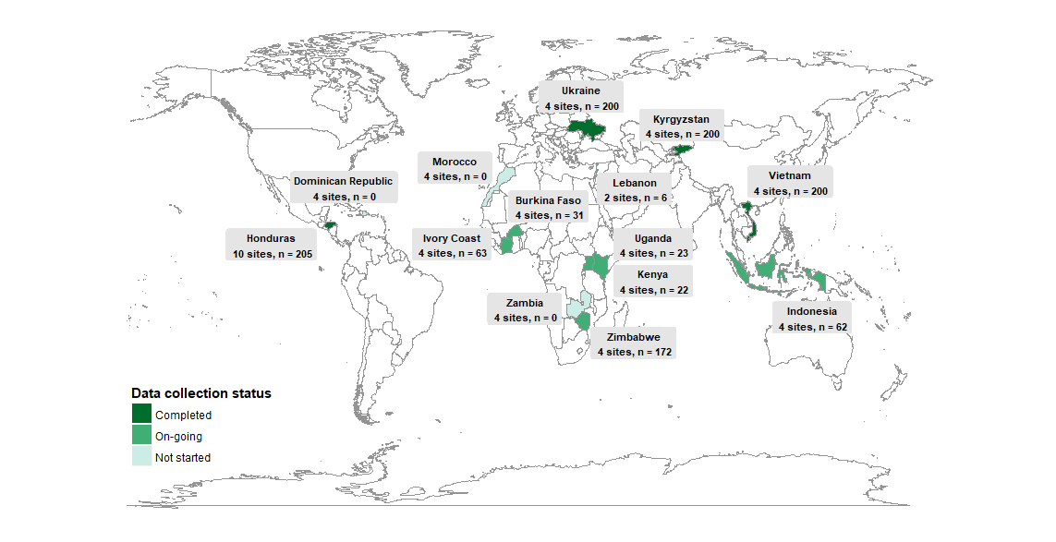
7 regions
n = 1 184 (19/07/18)
Notes:
We’re working in 7 regions where ITPC has a strong presence. The selection criteria to participate in the survey included only HIV+ adults (18+) diagnosed more than three months before the survey.
The sample for this intermediary report 1184 individuals from different countries depending on the status of data collection. Countries that have not started, it’s mainly due to long and cumbersome IRB processes. Honduras, Ukraine, Kyrgyzstan, Vietnam and Zimbabwe are more highly represented.

Slide 5
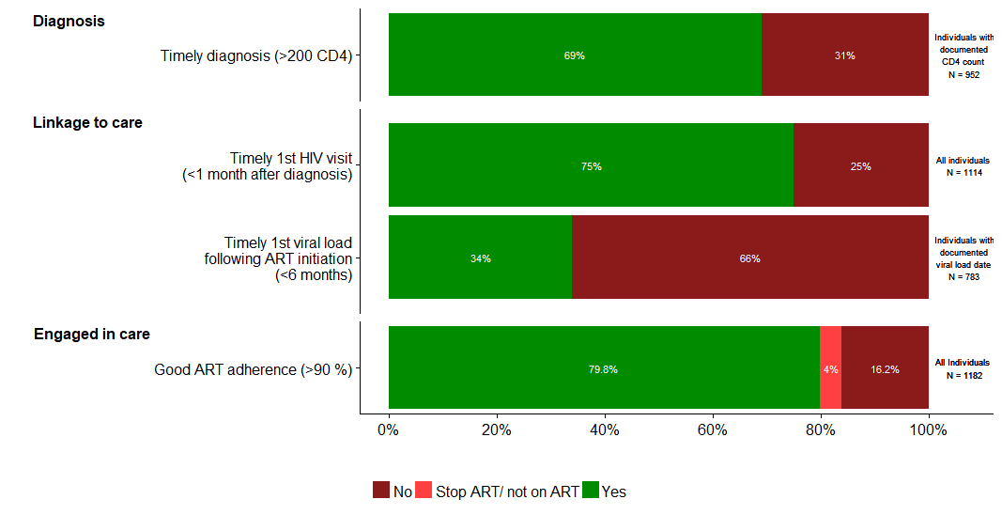
Timely 1st Viral Load After ART Start
Notes:
Where we see more gaps is in timely access to HIV services.
A large part of our sample was diagnosed at a late stage of the disease. 31% were diagnosed with a CD4 count below 200.
One fourth of our sample did not have timely Access to a first HIV visit after diagnosis.
The number of people accessing their first viral load within 6 months following ART initiation was particularly low (34%).
16% of individuals reported poor ART adherence.

Slide 6
Number of PLHIV that have done a viral load test compared with the Number of PLHIV that received their viral load test result within two weeks of taking the test – Cumulative Q1 2018
Viral Suppression
Qualitative analysis (focus groups) showed:
Continuous cases of stock out - lab reagents to perform the test (infrequently reported at national level)
Low coverage of viral load machines or low number of tests being performed despite availability of machines (i.e. Mali has 7 testing platforms with capacity to undertake 35,000 tests per year, but only did 1455 in 2017)
Delayed results - average turnaround time for recipients of care to receive results is 4.5 months (from the time of test)
Lack of communication about the importance of the viral load test "our peers still do not understand the importance and benefit of a viral load test"

Slide 7
Perspectives
“We are thinking now that people are taking blood to make money because I have had HIV for 18 years now, and had my blood taken 3 times and never gotten a result for my viral load test. We have no clue what is going on!”
Leader in PHLIV Network, The Gambia.
“I don’t know what you are talking about. Third line? The third line is the graveyard!” Leader in PHLIV Network, The Gambia.

Slide 8
INSIGHTS on Viral Load Testing (2015)
GOVERNMENT POLICY WITH NO IMPLEMENTATION
Two thirds of the 12 countries (8) surveyed, reported the existence of a government policy that mandates providers to conduct routine viral load testing as part of HIV treatment monitoring but only 3 countries were reported to have routine viral load testing
LOW HEALTH CARE PROVIDER INITIATIVE
Almost 60% of countries were reported to have viral load tests that are patient driven (not from health care providers)
NOT FREE
Greater than half of the countries surveyed reported that patients accessing VL are asked to pay for the service
Most countries reported that patients also have to pay for genotype testing if available
UNCLEAR HOW TO GET A TEST
The steps involved in viral load testing vary widely within and among countries and remain unclear
INCONSISTENT RESULT TURNAROUND TIME
The time it takes to receive VLT results varies by country ranging from 1 to 5 weeks to several months
All countries report stock outs of test kits and/or commodities related to VL testing within the past 12 months
Surveys report that countries suffer from delays in results due to staff leave, and stock outs
11 out 12 countries do not use electronic or mobile technologies to relay readiness of results to patients.
Notes:
Countries without a written government policy calling for RVL testing: 1. Cameroon 2. Swaziland 3. Uganda
4. Zimbabwe
Although routine in Kenya it’s 35 USD at minimum for someone to get the test where it not free…

Slide 9
INSIGHTS on Viral Load Testing (2015)
VL load availability is only part of the equation – it must be implemented, and implemented with treatment education and adherence support:
Patients need to and have a right to understand what their viral load tests mean
Poor support (counseling, social/community/peer) will likely have implications for adherence and ultimately resistance
Confusion among health care workers and recipients of care about:
use of and need for CD4, VL,
meaning of detectable vs suppression (1000, 200, U=U)
Notes:
TREATMENT EDUCATION POINT:
- In a room of 15 key population HIV treatment activists, 1 (a medical doctor) knew what a viral load test was and the difference between a VL and CD4 test.
What do results mean? CAN I TRANSMIT HIV IF I HAVE AN UNDETECTABLE VIRAL LOAD? Adherence clubs, peer support, buddy systems. I am quite eager to hear from MSF reports about their experiences with lay counselors
Our communities report some very incredible stories…ranging from people living with HIV who (WHEN FINALLY ARE EDUCATED ABOUT VL testing and ASK FOR IT) are turned back from VL test due to lack of staff, reagents, or inability to pay. Last story - young woman who heard about the importance of VL from a peer support group organization that ITPC works with in Uganda. Really quite sick. Travelled from her village to clinic, requested a test, paid for it, gave blood but don’t know what the results were, travelled back 2 times to collect but there were issues with the central lab getting results back to the clinic. Never went back. They are considering here a loss to follow up case now…can’t find her!!
So here we have people who are tested, initiated treatment, with enough support to get them to understand their treatment and need for monitoring… and we have a opportunity to intervene at a facility based level and provide a VL test, but the system is broken…this is heartbreaking

Slide 10
INSIGHTS on Viral Load Testing (2015)
Access still largely concentrated in major urban centers, with patients facing long delays in obtaining results
Communities need more machines and in non-urban centers for communities (example of project OPP-ERA and access to viral load in community-based organizations in Burundi) and need faster access to innovation (e.g. DBS)
Some countries still overpay for tests despite initiatives in place (such as Roche, UNAIDS, Unitaid, PEPFAR and GF joint program giving access to US$9.40 VL tests to 77 countries)

Slide 11
What VL testing means for communities
Understand and Want
Use result
Know where to access
Get result
VIRAL LOAD TEST
Save $ to go to get result
Save $ (transport, test)
Get the test done
Get to facility

Slide 12
Summary
CD4 necessary for initiation
CD4 necessary at initiation for baseline and AHD
VL is gold standard for knowing If your treatment is working
NOT READY to say less frequent VL, especially in the context of U=U and NTDs
Governments will this as an excuse to not scale RVLT as they are already struggling.
90-90-90 = 525 days to go!!!!
Success must be measured by getting to all who need it (age band, population) – Rural populations, distance to health centers?
Investment discussion shines a light on the inherent flaw of disease-specific initiatives.
Focus and investments must be on Health Systems Strengthening, COMMUNITY Systems Strengthening Approach

Slide 13
FIGURE IT OUT! GIVE US ONE, CLEAR MESSAGE

